Slide 1
MODULE 2: BASELINE ASSESSMENT
Session 8: Wealth Breakdowns
Notes:
Wealth breakdowns

Slide 2
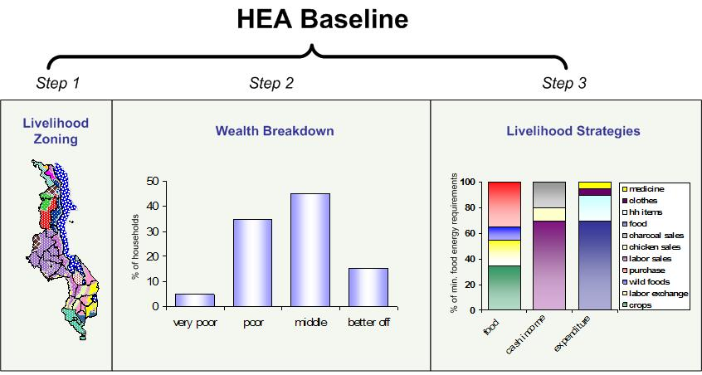
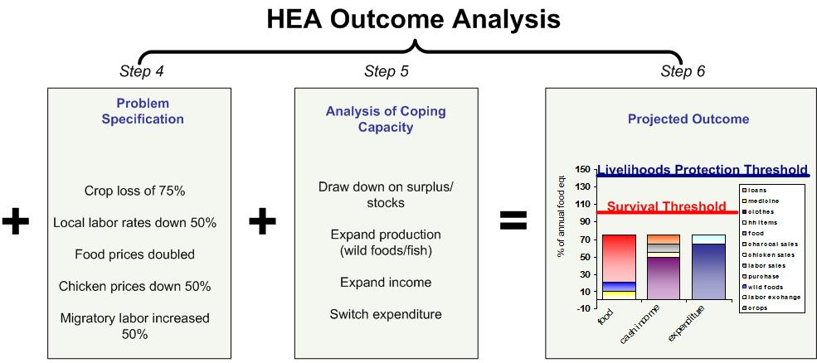
Where do Wealth Breakdowns fit?
Wealth breakdowns are the second step in the HEA baseline. This is an essential step before quantifying livelihood strategies.
Session 8: Wealth Breakdowns
Notes:
Wealth breakdowns

Slide 3
Why do we need Wealth Breakdowns?
Imagine…
If someone arrived in your village and asked:
How do people here obtain food?
How would you answer?
Session 8: Wealth Breakdowns
Notes:
Wealth breakdowns

Slide 4
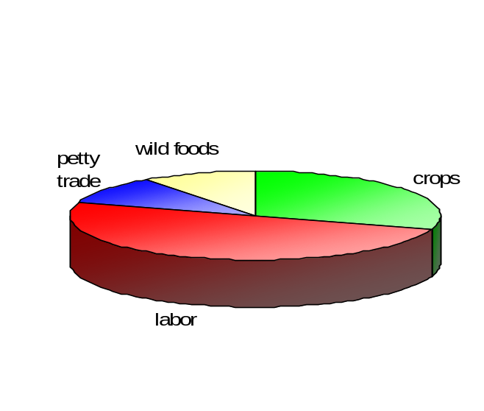
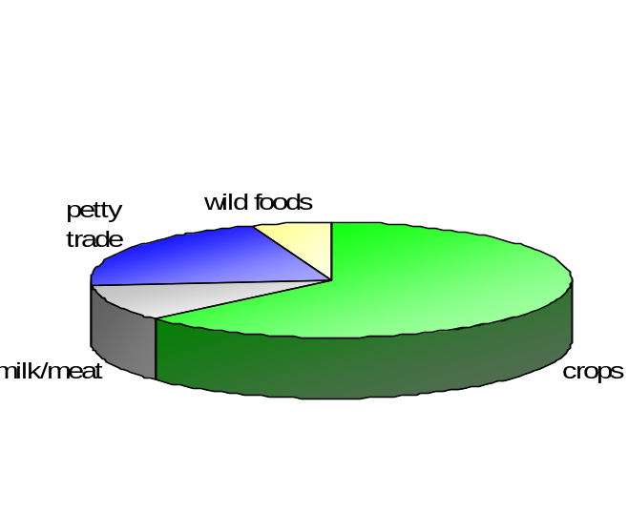
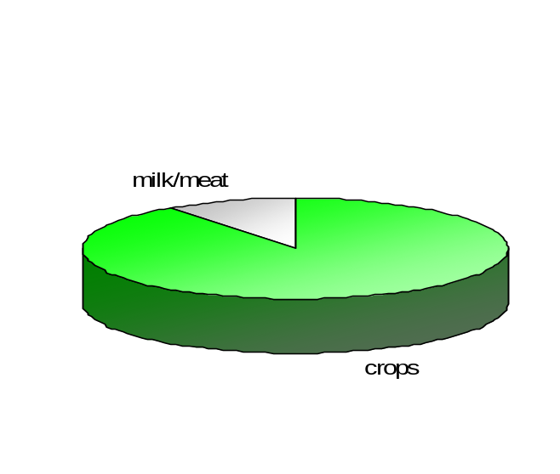
Why do we need Wealth Breakdowns?
How a household obtains access to food determines which shocks will affect it and to what degree
Poor hhs work for others, grow some of their own crops, collect wild foods, and engage in petty trade.
Middle hhs have more land and labour, so they can produce more of their own food, and make cash from petty trade.
Richer hhs, who have both more livestock and land holdings, produce surplus food.
poor
middle
rich
Session 8: Wealth Breakdowns
Notes:
Wealth breakdowns

Slide 5
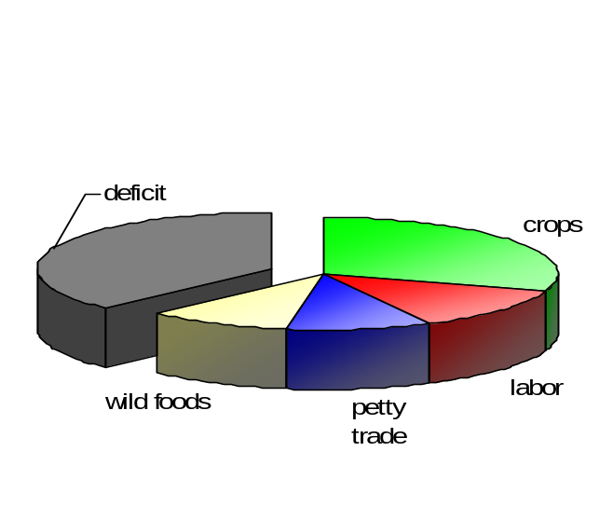
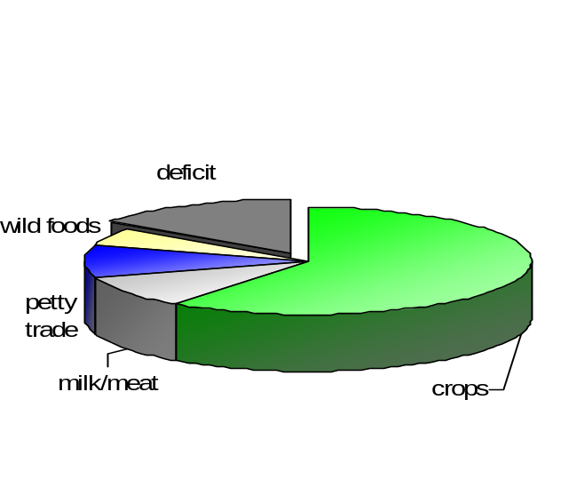
Why do we need Wealth Breakdowns?
A 50% drop in daily wages and doubling of staple food prices will…..
Hurt poor households the most
Create a smaller deficit for middle households
Not affect rich households at all
poor
middle
rich
Session 8: Wealth Breakdowns
Notes:
Wealth breakdowns

Slide 6
What is a Wealth Breakdown?
A Wealth Breakdown is:
A clustering of people into common wealth groups
Session 8: Wealth Breakdowns
Notes:
Wealth breakdowns

Slide 7
What is a Wealth Breakdown?
A Wealth Group is:
a set of households that employs the same general strategies for obtaining food and income. They live at roughly the same level of wealth and have the same capacity to cope with hazards
Session 8: Wealth Breakdowns
Notes:
Wealth breakdowns

Slide 8
What is a Wealth Breakdown?
We are using local not international measures of wealth
Session 8: Wealth Breakdowns
Notes:
Wealth breakdowns

Slide 9
What is a Wealth Breakdown?
What is at the root of differences in wealth?
Assets: Land, livestock, and capital
Education and Skills
Household size and composition (productive vs dependent members)
Social status (access to community resources)
Session 8: Wealth Breakdowns
Notes:
Wealth breakdowns

Slide 10
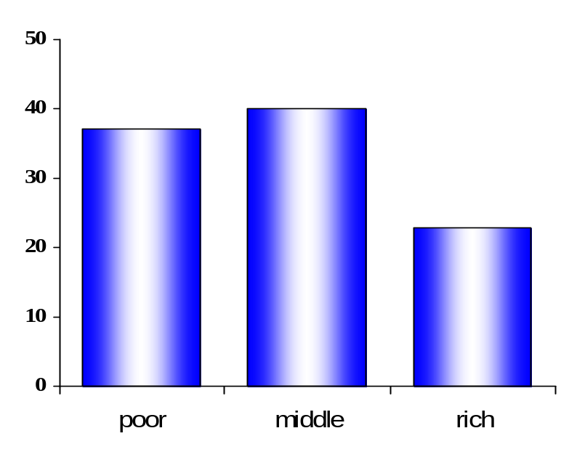
What is a Wealth Breakdown?
An example from Rumphi and Mzimba, Malawi
Wealth Group Information
HH Size | Area planted and how | Livestock
5 – 7 members | 1 – 1.5 acres by hand, using household labour | 0 – 4 pigs, 7 – 10 chickens
5 – 7 members | 2 – 3 acres by hand, using household labour and some hired labour | 0 – 5 pigs, 10 – 15 chickens
5 – 7 members | 4 – 5 acres by hand, using household and hired labour | 0-4 cattle, 3-7 goats, 2-6 pigs, 15-20 chickens
% of households
Land and labour are the main determinants of wealth here
Session 8: Wealth Breakdowns
Notes:
Wealth breakdowns

Slide 11
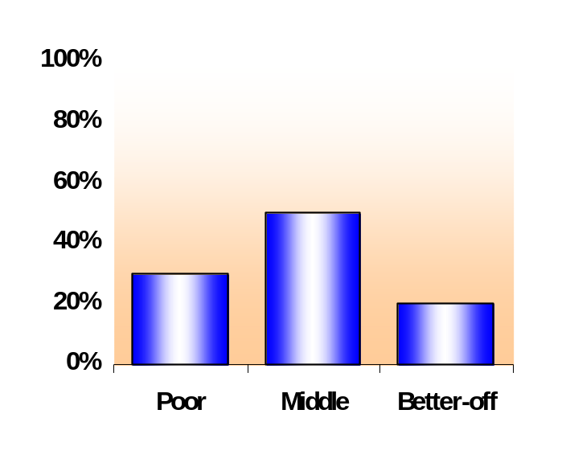
What is a Wealth Breakdown?
An example from a pastoral zone in Ethiopia
 | Poor | Middle | Better-off
Livestock Holdings: Sheep/goats Camels | 10-30 0-5 | 50-80 5-20 | 100-200 70-100
Household size Family structure | 6-7 1 wife | 7-9 1 wife | 9-10 1-2 wives
Labour employed | 0 | 1-2 | 2-3
Other Assets/ | 0 | 0-1 Berkads | 1-2 Berkads
Livestock holdings, labour and access to permanent water sources determine wealth in this zone
Session 8: Wealth Breakdowns
Notes:
Wealth breakdowns

Slide 12
How to do a Wealth Breakdown
Step 1: Find the right people
Step 2: Agree on determining criteria (land/livestock/labor)
Step 3: Decide on reasonable cut off points
Step 4: Use proportional piling to group
Step 5: Divide further if necessary
Session 8: Wealth Breakdowns
Notes:
Wealth breakdowns

Slide 13
How to do a Wealth Breakdown
In most cases you will need to divide the population into at least four groups:
Poor
Lower middle
Upper middle
Better off/Rich
Session 8: Wealth Breakdowns
Notes:
Wealth breakdowns

Slide 14
Things to keep in mind
What is a household?
Definition: The smallest coherent economic unit.
The basic community unit at which resources are managed; typically a group of people ‘eating from the same pot’
Session 8: Wealth Breakdowns
Notes:
Wealth breakdowns

Slide 15
Things to keep in mind
Types of households:
Monogamous: Husband, 1 wife + dependants
Polygamous: (all resources shared) Husband, more than 1 wife + dependants
Polygamous: (separate resources) Wife + dependants
Female-headed: woman + dependants
Session 8: Wealth Breakdowns
Notes:
Wealth breakdowns

Slide 17
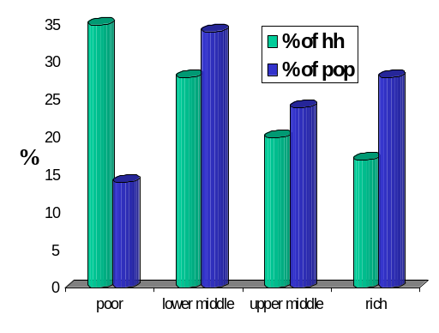
Things to keep in mind
If household size varies with wealth, the % of the population will differ from the % of households
In this case, there are more poor households than rich, but richer households are larger and represent a bigger % of the population
Session 8: Wealth Breakdowns
Notes:
Wealth breakdowns

